Slide 1


2025 Annual Report
Notes:
1

Slide 2
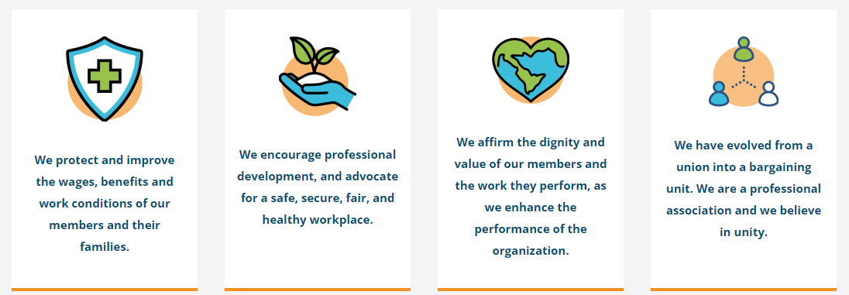
BCPSOPE Mission: Give our members a voice in the workplace
Notes:
This slide helps new members to understand what BCPSOPE is.
2

Slide 3
Ongoing Strategic Goals
Collaboration with BCPS Leadership to cultivate a positive work environment for employees
Collaboration with other BCPS Unions to support our workforce
Ombudsman support to our members and discounted legal services to support our members
Notes:
1: Superintendent, Deputy, Chief of Staff on communications, programs and benefits to improve work climate and morale. NICK GET EXAMPLES AND TIME LINE OR ANYTHING THAT HAS BEEN ACCOMPLISHED SO FAR.
2. UPED – talk more about . WHAT HOT BUTTON ITEMS HAVE BEEN DECIDED UPON WITH UPED
3. https://bcpsope.org/legal - Get a 30% discount
3

Slide 4

Ongoing Focus Areas
Increase employee membership and involvement
Advocate for the issues that directly impact our members
Provide honest and transparent communication
Notes:
Lead in to the next slides….
4

Slide 5
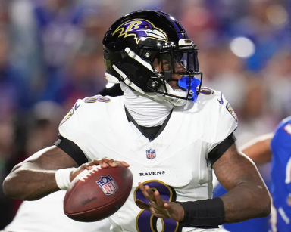
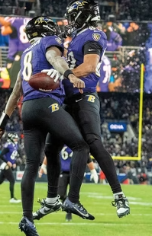
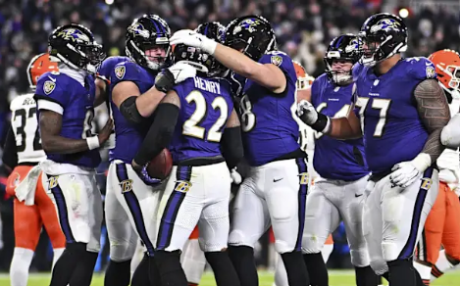
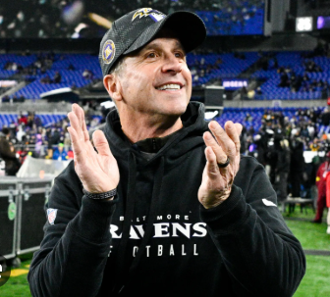
BCPSOPE 2025
Accomplishments
Negotiation Items
* Compensation pay
* Master Agreement updates
MOU’s
* Comp time
* Remote work
UPED coordination
Continued publication of the
“Voices” newsletter
Notes:
Last year activity
Monthly meetings with the Superintendent: When is the last time we surveyed members.
5

Slide 6
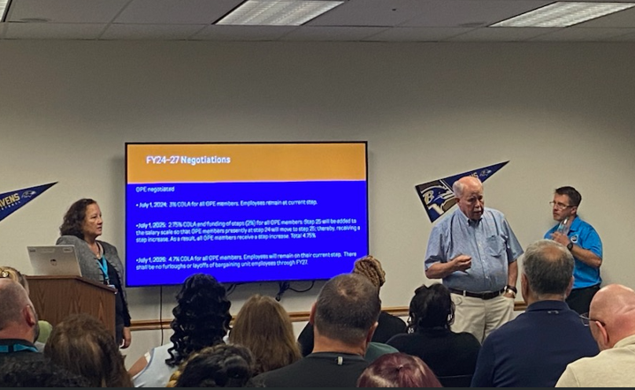
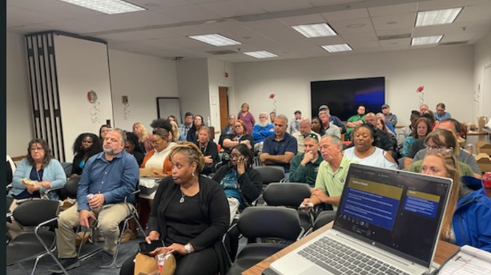
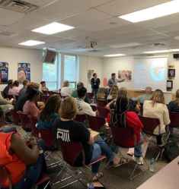
OPE TEAM
Notes:
This slide helps new members to understand what BCPSOPE is.
6

Slide 7
Negotiations
As you are aware BCPS had budget issues and the agreed upon salary increases were delayed for year 2 and 3.
Prior agreement
Year 1 of the Agreement: Effective July 1, 2024 (FY25), 3% COLA .
Year 2 of the Agreement: Effective July 1, 2025 (FY26), advance one step, 2.75% COLA and add Step 25
Year 3 of the Agreement: Effective July 1, 2026 (FY27), 4.7% COLA
Current MOU signed July 24, 2025
Year 2 of the Agreement: Effective September 20, 2025, 1% COLA
Effective January 1, 2026 (FY26), advance one step, Step 25 shall be added, employees on Step 24 shall advance to Step 25.
Effective January 1, 2026 (FY26), 1.75% COLA
Year 3 of the Agreement: Effective January 1, 2027 (FY27), 4.7% COLA.
Master Agreement articles were added or modified and can be referenced along with the new salary scales on the BCPSOPE website.
Notes:
This slide helps new members to understand what BCPSOPE is.
6

Slide 8
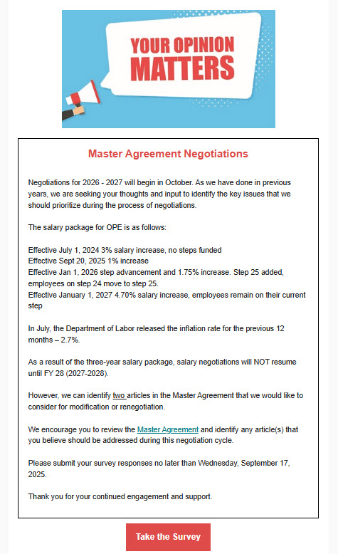
Upcoming negotiation items
BPCSOPE sent out an email on September 12, 2025 for your opinion.
Notes:
This slide helps new members to understand what BCPSOPE is.
7

Slide 9
Update on Telework
Bulk of the questions/concerns flow through our intake email.
We are working with BCPS leadership to establish clear guidelines on remote work opportunities.
At present, the opportunity for remote work varies by department and individual positions per the Department head approval.
If the employee is absent on their telework day, they cannot change it.
Notes:
8

Slide 10

BCPSOPE is run by volunteers
Notes:
Relates to ongoing focus areas “Building Member Membership” and “Member Support”
9

Slide 11
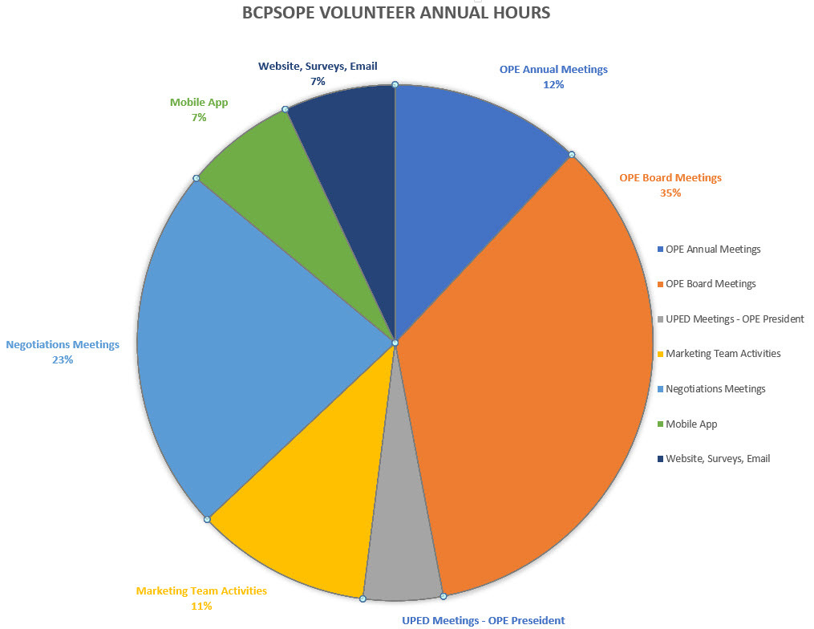

Slide 12
Member Benefits
Join system initiatives and committees | Survey input and use of OPE phone app
Ombudsman Service | Grievance Procedure Support
Discounted Legal Services | Negotiation participation opportunities
Member at Large opportunities | Participation at BCPSOPE Board meetings
Voices e-mail newsletter | Social/Networking Events
Notes:
Relates to ongoing focus areas “Building Member Membership” and “Member Support”
11

Slide 13
We appreciate your membership
Process to become a BCPSOPE member
Notes:
Relates to ongoing focus areas “Building Member Membership” and “Member Support”
Refer to the form on the website
12

Slide 14
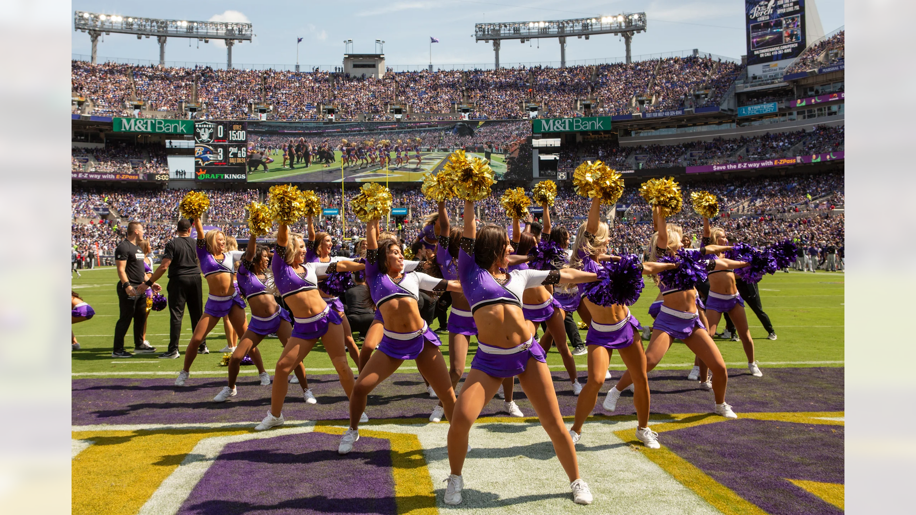

Notes:
13

Slide 15

12^{th year}
Notes:
14

Slide 16

Check the BCPSOPE
website for updates http://www.bcpsope.org
Thank you for your support!
Notes:
15

